Slide 1
Structure of Real-world Networks
MA 653: Network Science
Instructor: Ashok Singh Sairam
ashok@iitg.ac.in

Slide 2
Measuring and Modeling Networks
There are networks everywhere
What do they look like?
How do you measure and describe a billion node network?
What are the process that generate them?
Can we create models for real-life networks?
These two questions are related: We need to measure the characteristics that we want to model

Slide 3
Statistics for real networks:component

Slide 4
Components (1)
What are the component sizes in a real-world network?
Typically there is a large component that fills most of the network
Even more than 90% of the nodes
Rest of the network is divided in many smaller components disconnected from each other
The large components can arise
either due to the nature of the network
(e.g., Internet), or due to the
way the network was measured
(e.g., Web)

Slide 5
Components in directed networks (1)
The weakly connected components of directed networks behave similar to the components of undirected networks
There is a large weakly connected component and many smaller ones
The situation is similar with strongly connected components
There is a large strongly connected component and a selection of smaller ones
However, the large connected component is typically not “as large” as in the case of undirected networks
E.g., For the WWW, the largest connected component fills about a quarter of the network*

Slide 6
Bow-tie structure of web graph
Not all directed networks have large strongly connected components
E.g., acyclic networks (citation network)

Slide 7
Statistics for real networks:component

Slide 8
The small world effect
In many networks the typical network distances between vertices are surprisingly small
Small world effect (Remember the Stanley Miligram 1967 experiment. )
In math terms the small world effect is a hypothesis that the mean distance l is “small”
Typically networks have been found to have mean distance less than 20 – or in many cases less than 10 – even though the networks themselves have millions of nodes
Implications such as rumor spread in a social networks, response time in the Internet etc.

Slide 9
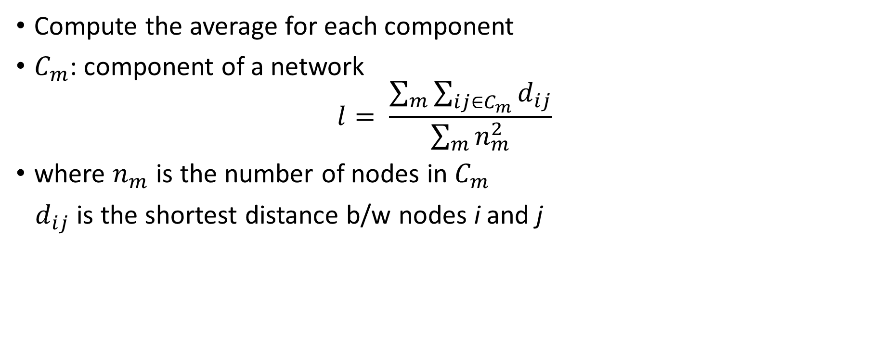
Computing shortest path
Compute the average for each component
$C_{m}$: component of a network
$$l= \frac{\sum_{m}{\sum_{ij∈C_{m}}{d_{ij}}}}{\sum_{m}{n_{m}^{2}}}$$
where $n_{m}$ is the number of nodes in $C_{m}$
$d_{ij}$ is the shortest distance b/w nodes i and j

Slide 10
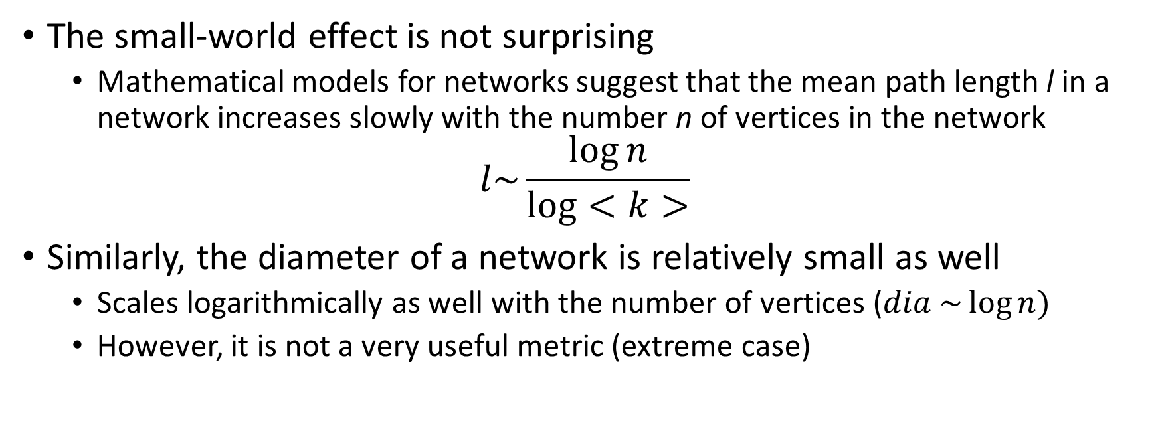
Shortest paths and the small-world effect
The small-world effect is not surprising
Mathematical models for networks suggest that the mean path length l in a network increases slowly with the number n of vertices in the network
$$l\sim \frac{\log{n}}{\log{<k>}}$$
Similarly, the diameter of a network is relatively small as well
Scales logarithmically as well with the number of vertices ($dia \sim \log{n)}$
However, it is not a very useful metric (extreme case)

Slide 11
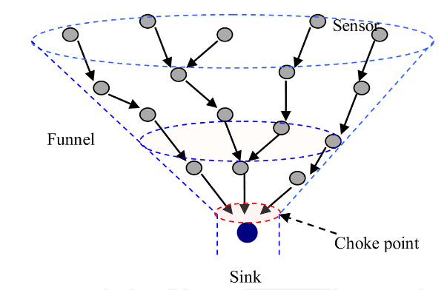
The small-world effect:Funneling
Funneling was observed by Milgram in his experiment
Most of the shortest paths to a sink vertex i go through one of its neighbors, so there is this funneling towards the destination
Most of the shortest path of vertex i go through one or two of its neighbors

Slide 12
Measuring and Modeling Networks

Slide 13
Degree distributions
Let p_{k} to be the fraction of vertices in a network that have degree k
Compute p_{k}
The quantities pk represent the degree distribution of the network.

Slide 14
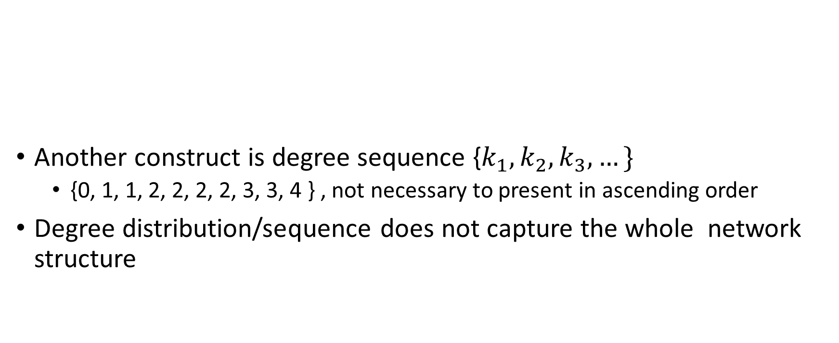
Degree distributions: Alternate construct
Another construct is degree sequence {$k_{1}, k_{2}, k_{3}, …\}$
{0, 1, 1, 2, 2, 2, 2, 3, 3, 4 } , not necessary to present in ascending order
Degree distribution/sequence does not capture the whole network structure
$$p_{0}=\frac{1}{10}, p_{1}=\frac{2}{10},p_{2}=\frac{4}{10}, p_{3}=\frac{2}{10},p_{4}=\frac{1}{10},p_{k}=0∀k≥5$$

Slide 15
Ex: Same degree but different network structure
Consider these two networks. Compute their degree distribution.
Figure B
Figure A

Slide 16
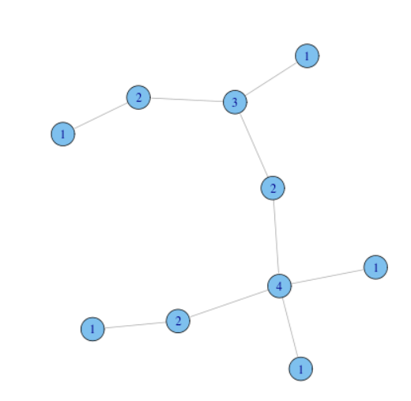
Plot of degree distribution
Plot
y-axis: p_{k}
x-axis: k

Slide 17
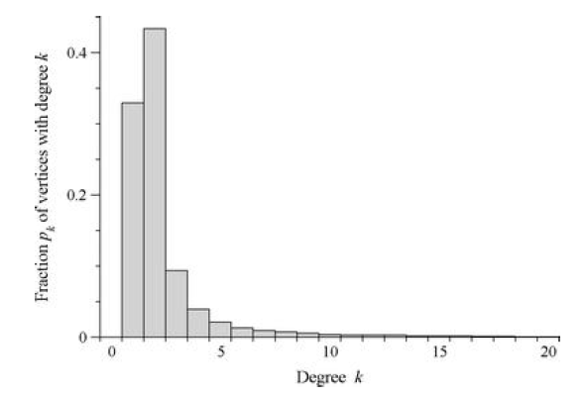
Plot of Degree distribution
Many nodes with small degrees, few with extremely high
But there is a significant tail corresponding to nodes with substantially higher degree
Largest degree is 2407
There are 19956 nodes in total
That is the largest degree node is connected to 12% of the whole network in one hop
Such nodes are called hubs
Rightly skewed

Slide 18
Degree distribution in directed networks
For directed networks we have both in- and out-degree distributions

Slide 19
Degree distribution in directed networks
In directed networks we can also define a joint in- and out degree distribution p_{jk}
p_{jk} is the fraction of vertices that have simultaneously an in-degree j and an out-degree k
The joint distribution can allow to identify correlations between the in- and out-degrees
This is not possible with the two separate, one-dimension, degree distributions

Slide 20
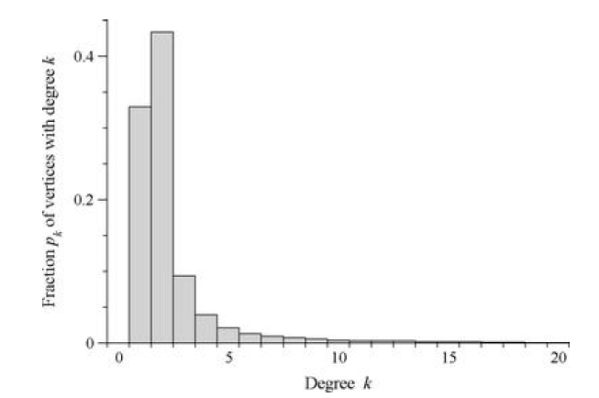
Power law degree distribution
both axes are logarithmic. We have also made the range of the bins bigger in the histogram to make the effect clearer—they are of width five in Fig. 8.5 where they were only of width one before.
axis of the histogram
Replotted degree distribution
on logarithmic scale

Slide 21
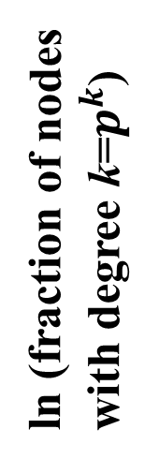
Power law graphs
Number of nodes with degree k is ~
1 100 10000 1M
ln (fraction of nodes
with degree k=$p^{k}$)
Power law
Heavy tailed
Exponential
1 10 100 1000
ln (node degree=k)

Slide 22
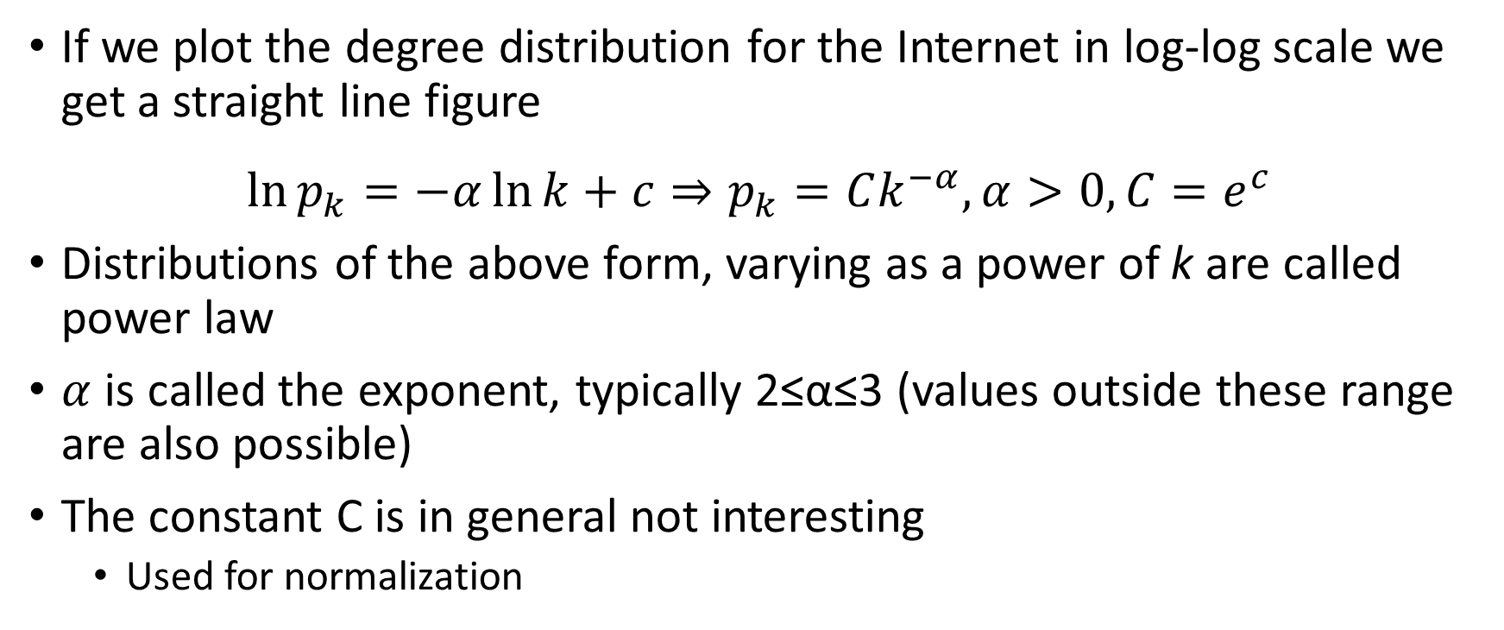
Power law networks
If we plot the degree distribution for the Internet in log-log scale we get a straight line figure
$$\ln{p_{k}=−α\ln{k}+c⇒p_{k}=Ck^{−α},α>0, C=e^{c}}$$
Distributions of the above form, varying as a power of k are called power law
$α$ is called the exponent, typically 2≤α≤3 (values outside these range are also possible)
The constant C is in general not interesting
Used for normalization

Slide 23
Statistics for real networks: power-law exponent
Notes:
n

Slide 24
Power laws and scale free networks
Real networks do not follow power law degree distribution over the whole range of k
Usually when we say a degree distribution follows a power law we refer to its tail
Deviations from power law can appear for high values of k as well
E.g., cut-offs that limit the maximum degree of vertices in the tail
Networks that follow power law degree distribution are often referred to as scale-free networks
Identifying scale-free from non scale-free networks is not trivial
Simplest – but not very accurate - strategy → log-log plot is a straight line

Slide 25
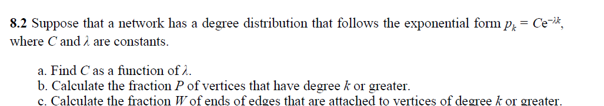

Slide 26
Power law distribution
$$p_{k}=Ck^{−α},α>0, C=e^{c}$$
Identifying power-law from non power-law distributions is not trivial
Approaches:
Visual examination of log-log plot; linear plot => power law
Not very accurate
Binning/histogram:
Create bins and logarithmically scale the axis of the histogram

Slide 27
Ex: Binning
Poor statistics at the tail of the distribution
In every bin there will be only a few samples → large statistical fluctuations in the number of samples from bin to bin → visible as a noisy signal
use larger bins to reduce the noise at the tail
reduces the detail captured from the histogram
a bin of width five will on average accrue five times as many samples as a similarly placed bin of width one, so if we wish to compare counts in the two we should divide the number of samples in the larger bin by five. More generally, we should divide sample counts by the width of their bins to make counts in bins of different widths comparable.
Noisy at the tail

Slide 28
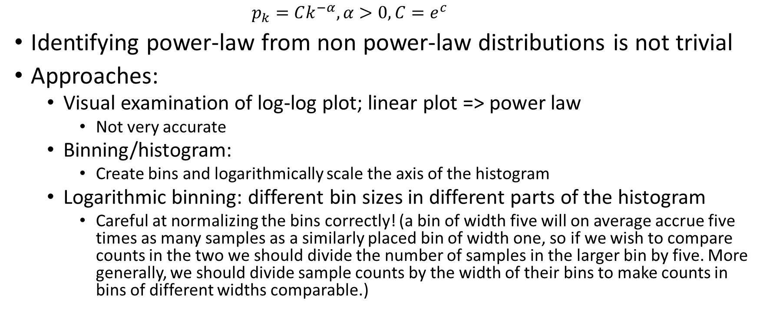
Power law distribution
$$p_{k}=Ck^{−α},α>0, C=e^{c}$$
Identifying power-law from non power-law distributions is not trivial
Approaches:
Visual examination of log-log plot; linear plot => power law
Not very accurate
Binning/histogram:
Create bins and logarithmically scale the axis of the histogram
Logarithmic binning: different bin sizes in different parts of the histogram
Careful at normalizing the bins correctly! (a bin of width five will on average accrue five times as many samples as a similarly placed bin of width one, so if we wish to compare counts in the two we should divide the number of samples in the larger bin by five. More generally, we should divide sample counts by the width of their bins to make counts in bins of different widths comparable.)

Slide 29
Logarithmic binning
In this scheme each bin is made wider than its predecessor by a constant factor a
The n-th bin will cover the range: a^{n-1} ≤ k < a^{n}
The most common choices for a are 2 and 10 since larger values of a give ranges that are too big, and smaller a values give non-integer ranges limits
When plotted in log-log scale, the bins appear to have equal width
We do not plot degree zero
Since there is no 0 in a log scale

Slide 30
Binning versus logarithmic binning
We have been careful to normalize each bin by dividing by its width, as described above
$$0=\log_{10}{1}$$
$$1=\log_{10}{10}$$
$$2=\log_{10}{100}$$

Slide 31
Power laws and scale free networks
Networks that follow power-law degree distribution are referred to as scale-free networks
Scale-free network: means these networks have the same functional form at all scales
The power law remains unchanged (other than the multiplicative factor) when scaling the independent variable k
Real networks do not follow power-law degree distribution over the whole range of degrees k
That is the degree distribution is not monotonically decreasing over the whole range of degrees
Many times we refer to its tail only (high degrees)
Deviations from power law can appear for high values of k as well

Slide 32
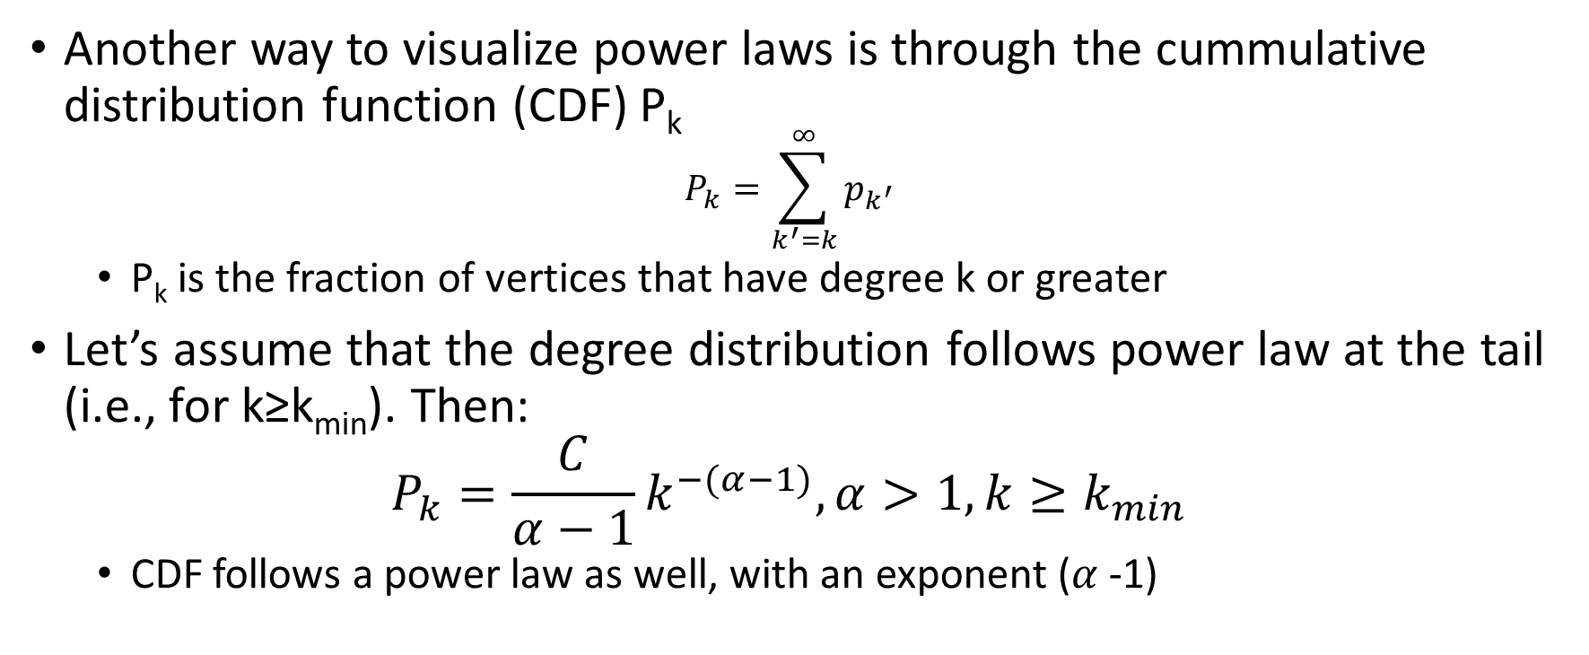
Cumulative distribution function
Another way to visualize power laws is through the cummulative distribution function (CDF) P_{k}
$$P_{k}=\sum_{k^{′}=k}^{∞}{p_{k^{′}}}$$
P_{k} is the fraction of vertices that have degree k or greater
Let’s assume that the degree distribution follows power law at the tail (i.e., for k≥k_{min}). Then:
$$P_{k}=\frac{C}{α−1}k^{−(α−1)}, α>1,k≥k_{min}$$
CDF follows a power law as well, with an exponent ($α$-1)

Slide 33
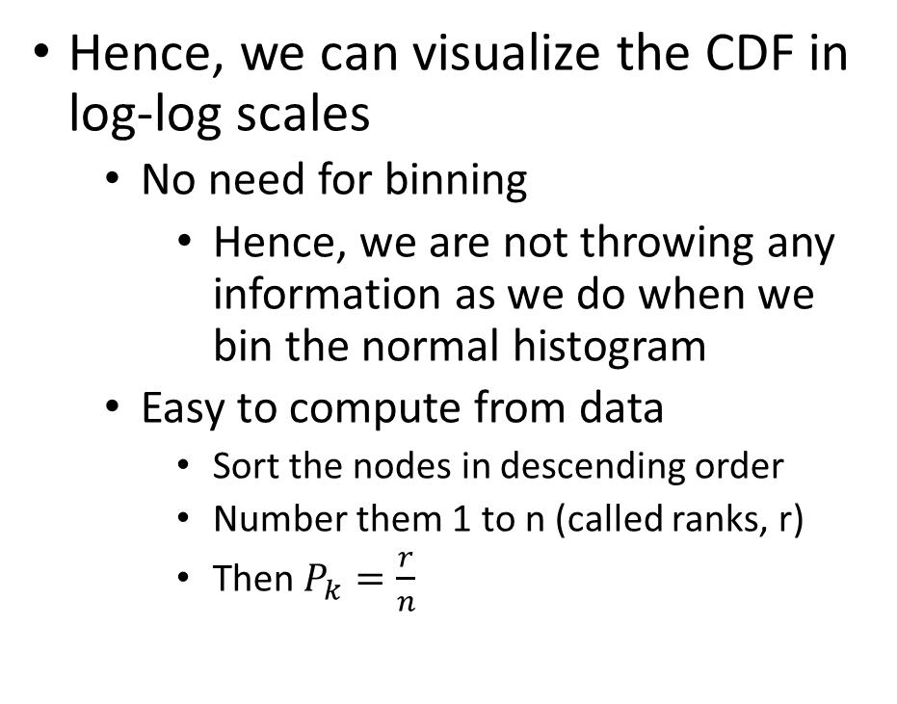
Cumulative distribution function
Hence, we can visualize the CDF in log-log scales
No need for binning
Hence, we are not throwing any information as we do when we bin the normal histogram
Easy to compute from data
Sort the nodes in descending order
Number them 1 to n (called ranks, r)
Then $P_{k}=\frac{r}{n}$
The cumulative distribution function is also easy to calculate. The number of vertices with degree greater than or equal to that of the rth-highest-degree vertex in a network is, by definition, r. Thus the fraction with degree greater than or equal to that of the rth-highest-degree vertex in a network is Pk = r/n. So a simple way of finding Pk is to sort the degrees of the vertices in descending order and then number them from 1 to n in that order. These numbers are the so-called ranks ri of the vertices. A plot of ri /n as a function of degree ki , with the vertices in rank order, then gives us our cumulative distribution plot

Slide 34
CDF example
Compute the CDF of the following graph
Degree k | Rank r | P_{k}=r/n

Slide 35
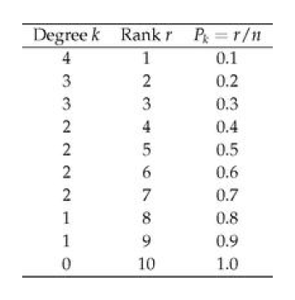
Then a plot of the last column as a function of the first gives us our cumulative distribution function.

Slide 36
CDF disadvantages
Less easy to interpret as compared to normal histograms
Since they are indirectly related to the degree distribution
Successive points on a CDF plot are correlated
Adjacent values are not independent
Not appropriate to extract the value of the exponent by standard techniques (e.g., least squares) that assume independence between data points
In general, it is not a good practice to fit straight line to either CDF or normal histograms
Biased estimations for different reasons

